Slide 1
RESUME WRITING

Slide 2
Making Your Resume Pop

Slide 3

Pop Quiz!
What is the initial amount of time an employer takes to review an applicant’s resume?
  Answer:
    15 – 20 seconds minimum
    45 seconds maximum

Slide 4

Why do you need a resume?
A marketing tool
To obtain an interview, not a job
Requirement of many organizations

Slide 5
Resume- hidden messages
Resume
You
Neat
Well-organized
Error free
Professional appearance
Neat
Well-organized
Attention to detail
Careful & Competent

Slide 6
Sections of a Resume

Slide 7
The Header
What should be included?
  Name
  Permanent and present address
  E-mail address
  Telephone number
Where should contact information go?
  Top of the page

Slide 8
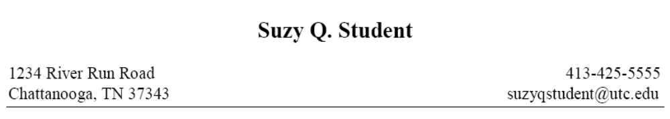

Slide 9
Objective Statement
Purpose
  Communicate the type of position you are interested in
Examples
  Management trainee position with a specialty retailer.
  Technical sales with an energy related industry in the Southwest. Long range goals of regional sales management.
  To obtain a position as field service representative with XYZ Software Corporation.

Slide 10
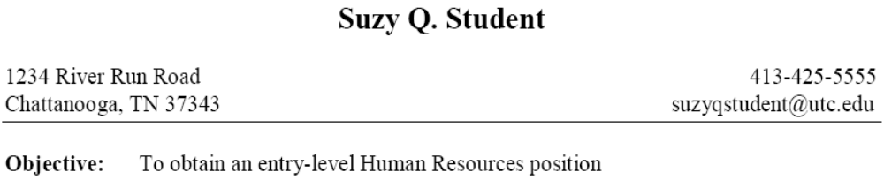

Slide 11
Education
Name of Institution
  Include city and state if not part of the title
Name of your degree and major
  Bachelor of _________ in ___________
    Bachelor of Science in Business Administration: Accounting
List degrees in reverse chronological order
  Most recent degree is listed first

Slide 12
Education
Date or expected date of graduation
  Graduation Date: May 2014
  Expected Graduation Date: May 2015
GPA
  Major or overall at least 3.0
  Round down to the nearest tenth
    3.0 not 3.062
    GPA: 4.0, Summa Cum Laude
High School Information
  Do not include after Sophomore year

Slide 13
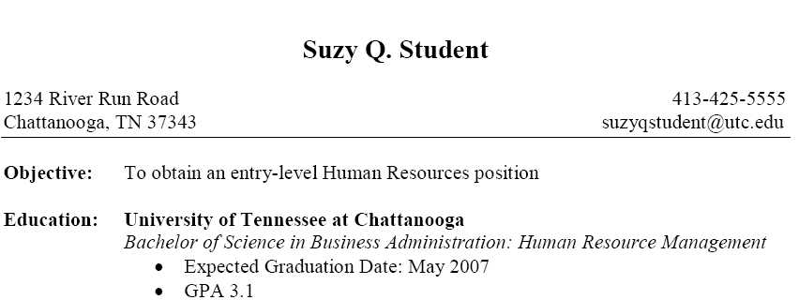

Slide 14
Experience
Use the term "experience"
  What is considered experience?
    Full and part-time jobs
    Self-employment
    Volunteer work
    Practicum, field, and cooperative education
  Information to include
    Job Title
    Dates of employment
    Company name
    City & State

Slide 15
Listing Responsibilities
Use bullet points
Start of each line with an action verb
  Present tense if currently employed
  Past tense if no longer employed
  Vary your choice of verbs
Tailor skills and experiences to the position for which you are applying
Be concise while providing enough detail

Slide 16
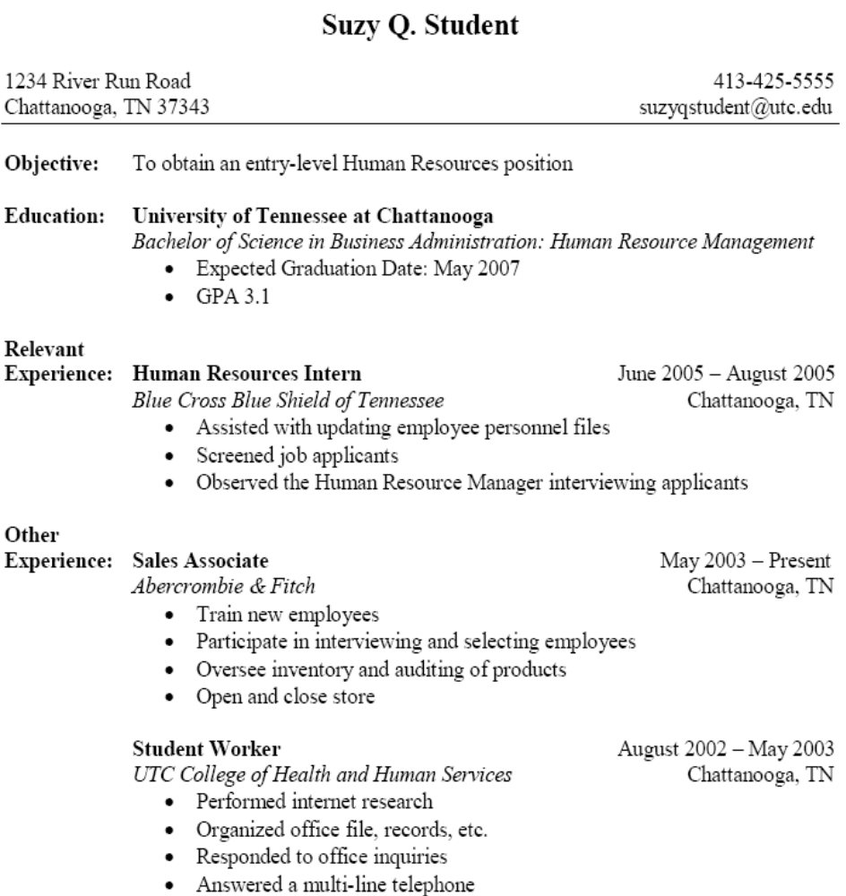

Slide 17
Honors & Awards
Order by dates
  Reverse chronological
Rank order by importance to the career objective

Slide 18
Professional Affiliations & Activities
Order by date
  Reverse chronological
Rank order by importance to the career objective
Do not say Member of …
Emphasize your leadership roles
Spell out the organization’s name:
  Do not use abbreviations or acronyms

Slide 19
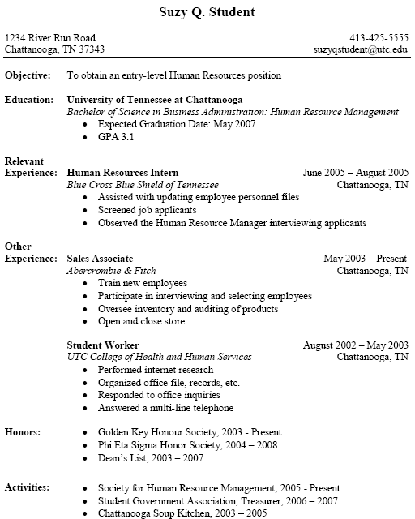

Slide 20
Resume Dos
Use action verbs
Use short, concise sentences
Use #, %, $ amounts
Keep resume easy to read
Keep resume about one page

Slide 21
Resume Don’ts
Do not use the pronouns such as I, me, my, etc.
Do not include references
Do not clutter your resume with nonessential information
Do not make any misrepresentations
Do not include personal information
  SSN, age, sex, height, weight, marital status, photograph, etc.

